Slide 1



Introduction
Upamanyu Madhow
ECE Department
University of California, Santa Barbara

Slide 2
2 decades of wireless growth
Digital cellular is now global
6B mobile phone subscribers today!
Connects the most remote locations to the global economy
WiFi is pervasive and growing
Huge growth in carrier and enterprise markets
Huge potential in residential markets in developing nations
Technology is was converging
MIMO, OFDM part of all modern standards
mmWave represents a fundamental disruption

Slide 3
mm-wave: what’s different?
System goals: multiGbps wireless
Bandwidth no longer a constraint
Channel characteristics
Sparse rather than rich scattering
The nature of MIMO
Beamforming, diversity, multiplexing all different at tiny wavelengths
Signal processing at multiGbps speeds
ADC is a bottleneck, OFDM may not be the best choice
Networking with highly directional links
So really, everything is different!

Slide 4
Interdisciplinary approach is essential

Slide 5






Example: NSF GigaNets project
Circuits
Buckwalter (UCSB)
Arbabian (Stanford)
Rodwell (UCSB)
+
Systems
Madhow (UCSB)
Zheng (U. Chicago)
Zhang (UCSD)

Slide 6
The Opportunity
Technology and Applications

Slide 7
The end of spectral hunger?
60 GHz: 14 GHz of unlicensed spectrum!
(freq, GHz)
55
60
65
70
USA
Oxygen absorption
(ideal for short-range, multihop)
Recently opened up
No oxygen absorption
Longer range links, esp with no rain
E/W bands: 13 GHz of semi-unlicensed spectrum
70
75
80
85
90
95
Bands beyond 100 GHz becoming accessible as RFIC and packaging
technology advances

Slide 8
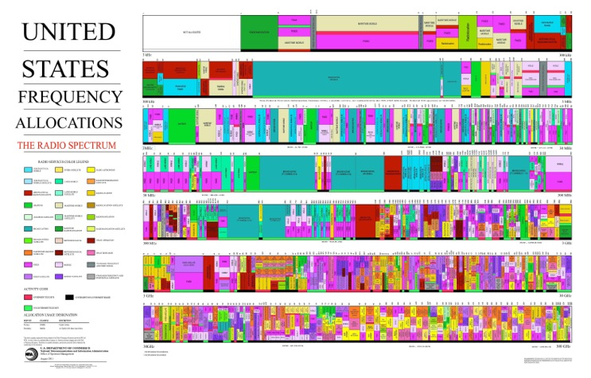
To put it in perspective
Conventional
Cellular
Original 7 GHz unlicensed
band at 60 GHz
Equivalent spectrum
Notes:
FCC federal communications comission
Mmwave is not a new discovery..
These boxes in there shows that these spectrum are also been owned by people but haven’t been used widely…

Slide 9
We now have a virtuous cycle
Technology
Applications
Mm-wave in silicon
Packaging advances
WLAN, cellular,
backhaul, radar
Unlicensed
Semi-unlicensed
Regulations

Slide 10
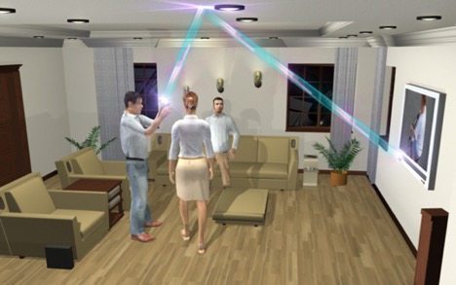
Initial industry focus: indoor 60 GHz networks
WiGig spec/IEEE 802.11ad standard: up to 7 Gbps
Support for moderately directional links
32 element antennas that can steer around obstacles
www.technologyreview.com

Slide 11

Progress due to push for WiGig
60 GHz CMOS RFICs
WiFi-like economies of scale if and when market takes off
Antenna array in package (32 elements)
Good enough for indoor consumer electronics applications
MAC protocol supporting directional links
Good enough for quasi-static environments
Does not provide interference suppression
Does not scale to very large number of elements
Gigabit PHY
Standard OFDM and singlecarrier approaches
Does not scale to 10 Gbps at reasonable power consumption (ADC bottleneck)

Slide 12
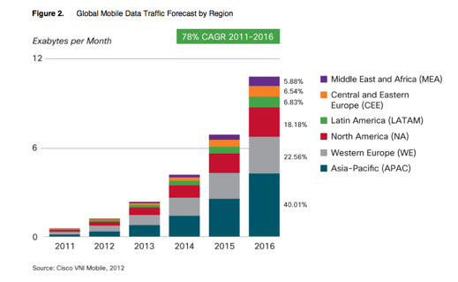


Now: mmWave for 5G
Driven by exponential growth in cellular data demand
NEED EXPONENTIAL INCREASE IN
CELLULAR NETWORK CAPACITY
(without breaking the bank)

Slide 13
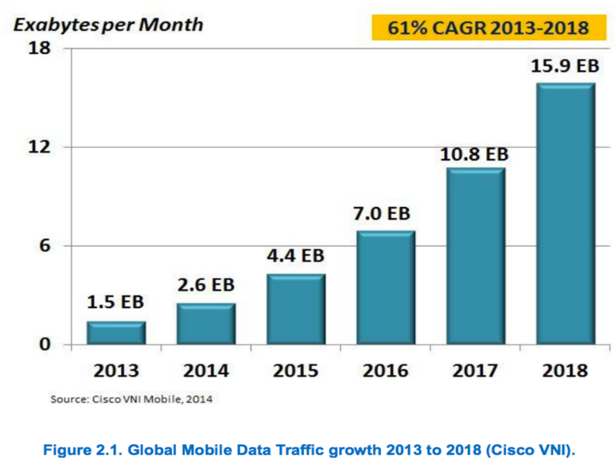


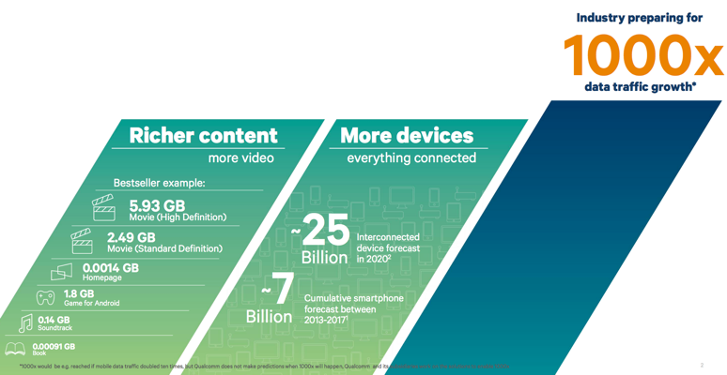
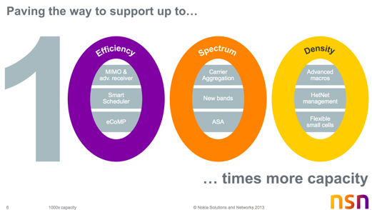
Industry consensus on the need for Cellular 1000X
Figure courtesy:
Nokia
Figure courtesy:
Qualcomm
Figure courtesy: Cisco
Notes:
The thirst for mobile data will grow exponentially
Shannon’s law (nWlog(1+SNR))

Slide 14

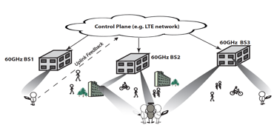
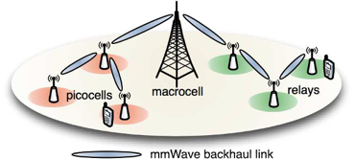
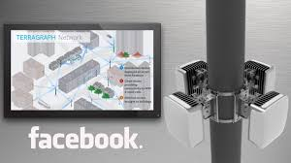
Mm-wave enables aggressive spatial reuse
32 x 32
8 x 8 cm²
Large arrays in small form factors
Directive links
Limited interference
Dense cells / much higher spatial reuse
Terragraph
(WiGig repurposed)
Access
Backhaul

Slide 15
1000X via mm-wave
Spectral efficiency (SNR)
Directive antennas but higher noise figure
0.1-1X
Bandwidth (W)
Up to a few GHz
10-100X
Cell density (n)
High spatial reuse
100X

Slide 16

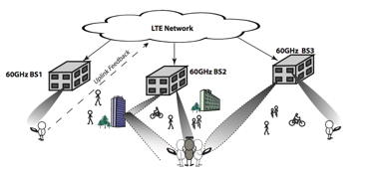
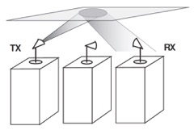
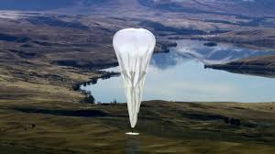
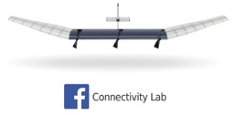
mm-wave comm: a snapshot

Slide 17


In addition…mmWave commodity radar
Vehicular situational awareness
Gesture recognition
Designs constrained by cost, complexity and geometry
Very different from classical long-range military radar

Slide 18
Challenges
(aka Research Opportunities)

Slide 19
Must revisit all key concepts in wireless design
Revisiting channel models for tiny wavelengths
Sparse, easily blocked
Critical role of directionality
Geometric rather than statistical view of MIMO
Revisiting signal processing architectures
The ADC bottleneck
Revisiting networking
Highly directional links change MAC design considerations
Multi-band operation (e.g., 1-5 GHz and 60 GHz)
Revisiting radar
Short-range geometry and hardware constraints
Inherently cross-layer even at the level of comm and estimation theory
Node form factor, hardware constraints, propagation geometry

Slide 20

Channel Modeling
Slides mostly due to: Maryam Eslami Rasekh

Slide 21
Step 0: can we close the link?
Take-away from link budget
Low-cost silicon works for indoor links
Low-cost silicon also works for short outdoor links
(~100 meters)

Slide 22
Is propagation on our side?
Can we attain the kind of system specs we want with technology compatible with the mass market?
Link budget for indoor links
Link budget for outdoor links (oxygen absorption)
CMOS power amps: sweet spot 0-10 dBm
SiGe power amps can go higher
Using antenna arrays, can we go far enough so it is interesting?

Slide 23
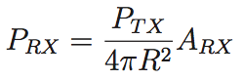
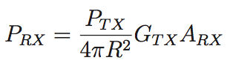
Free space propagation
The simplest model for how transmit power translates to received power
Isotropic transmission ➔ at range R, the power is distributed over
the surface of a sphere of radius R
Receiver antenna provides an aperture with an effective area for
catching a fraction of this power
Receive antenna
aperture
If the transmitter uses a directional antenna:
Transmit antenna
gain

Slide 24
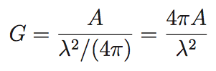
Relating gain to aperture
Antenna gain = ratio of aperture to that of an isotropic antenna
Aperture for an
“isotropic” antenna
Remarks
--For given aperture, gain decreases with wavelength
--Aperture roughly related to area ➔ at lower carrier frequencies
(larger wavelengths) we need larger form factors to achieve
a given antenna gain

Slide 25
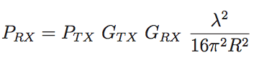
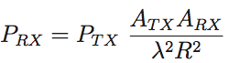
Friis’ formula for free space propagation
Given the antenna gains:
For fixed antenna gains, the larger the wavelength the better
Given the antenna apertures:
For fixed antenna apertures (roughly equivalent to fixed form factors),
the smaller the wavelength the better, provided we can point the
transmitter and receiver at each other

Slide 26
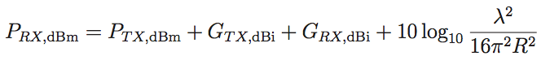
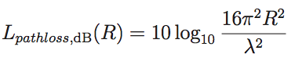
Applying Friis’ formula
Going to the dB domain:
More generally:
Plug in your
favorite model
for path loss
Free space path loss model gives us back the first formula:

Slide 27
Link budget
Given a desired receiver sensitivity (i.e., received power),
what is the required transmit power to attain a desired range?
OR
what is the attainable range for a given transmit power?
Must account for transmit and receive directivities, path loss, and
add on a link margin (for unmodeled, unforseen contingencies)

Slide 28
Link budget analysis
Basic comm theory maps modulation & coding scheme to Eb/N0
requirement; we then need to map to received power needed
Receiver sensitivity: minimum received power required to attain
a desired error probability
(depends on the modulation scheme, bit rate, channel model,
receiver noise figure)
We can now design the physical link parameters: transmit and receive
antennas, transmit power, link range
Link budget: Once we know the receiver sensitivity, we can work
backward and figure out the physical link parameters required
to deliver the required received power (plus a margin of safety)

Slide 29
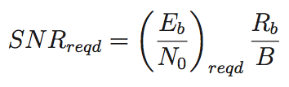
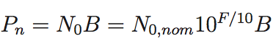
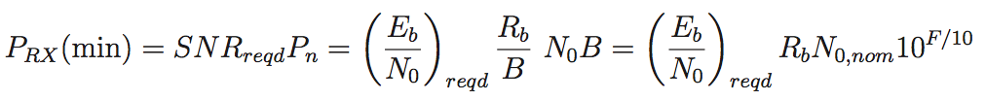
Receiver sensitivity
(noise power)
Receiver sensitivity (minimum receive power needed)

Slide 30
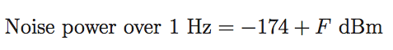
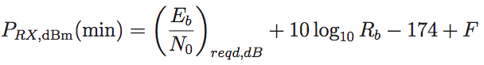
Receiver sensitivity in dBm
At room temperature and for a bandwidth of 1 Hz, the noise power
equals -174 dBm
(for noise figure
of F dB)
We therefore obtain
How should we design the system to attain the desired RX sensitivity?
Need to relate transmit power to received power

Slide 31
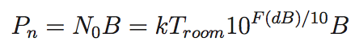
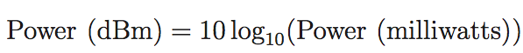
Numerical value of noise PSD
White noise arising from many devices in the receiver can be summarized into a single quantity Noise figure: tells us how big the PSD is with respect to a benchmark
Benchmark: thermal noise of a resistor with matched impedance at “room temperature”
Noise figure usually expressed in dB, and noise power can be computed as follows:
Power often expressed in dBm

Slide 32
Example 60 GHz indoor link budget
2.5 Gbps link using QPSK and rate 13/16 code operating 2 dB
from Shannon limit
Noise figure 6 dB
Receiver sensitivity = -71.5 dBm
4x4 antenna array at each end, 2 dBi gain per element
➔ 14 dBi gain at each end
10 m range ➔ free-space path loss is about 88 dB
Transmit power with 10 dB link margin is only about -1.5 dBm!
(➔ can use less directive antennas)

Slide 33
Example 100 m outdoor 60 GHz link (backhaul, base-to-mobile)
Using 10 m indoor link budget as reference
Free space propagation loss increases by 20 dB
Oxygen absorption (16 dB/km) leads to 1.6 dB additional loss
Rain margin (25 dB/km for 2 inches/hr): 2.5 dB
Required transmit power goes up to 22.6 dBm
For 4x4 array, TX power per element is 10.6 dBm
(doable with CMOS, easy with SiGe)
EIRP = 22.6 dBm + 14 dBi = 36.6 dBm < FCC EIRP limit of 40 dBm

Slide 34
What the link budgets tell us
60 GHz is well matched to indoor networking and to picocellular networks
Oxygen absorption has limited impact at moderate ranges
Heavy rain can be accommodated in link budget
Moderate directivity suffices
Electronically steerable links give flexibility in networking
Low-cost silicon implementations are possible
For truly long range, need to avoid oxygen absorption
64-71 (unlicensed), 71-76, 81-86 GHz (semi-unlicensed)
Bands above 100 GHz
Need very high directivity (can we steer effectively?)

Slide 35
Step 1: Channel Characterization
Take-away
Sparse, geometrically predictable channels
Very different from statistical models used at lower frequencies

Slide 36


Basics of channel modeling
Sum of propagation paths
Free space propagation (LOS)
Specular reflection
Propagation through dielectric obstacles
Diffraction and scattering
All these components are strong in conventional lower frequency bands (<6GHz) but in mmwave..?

Slide 37
reflection

Slide 38
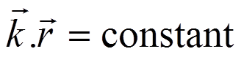
Reflection
Plane wave traveling in homogenous environment
constant phase plane
(wave front)
(phasor)
Magnetic permeability
Electric permittivity
Relative permittivity
Relative permeability
Magnetic permeability of vacuum
Electric permittivity
of vacuum

Slide 39
Reflection
Plane wave reflection and transition: Snell’s law
Speed of light in substance

Slide 40
Reflection coeffs
Fresnel formula derived from Maxwell’s equations
Depend on magnetic permeability and electric permittivity

Slide 41
Reflection
Note: for normal surfaces perpendicular reflection coefficient is negative

Slide 42
Reflection
Note: for normal surfaces perpendicular reflection coefficient is negative
and for parallel reflection we have:

Slide 43
Reflection coeffs have mild freq dependence
Quasi-plane wave:
TX
RX

Slide 44
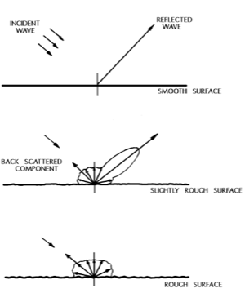
Main freq dependence is from rough scattering
Reflection from rough surfaces: part of wave energy is scattered
Higher loss at higher frequencies (exponential)
(surfaces are rougher at shorter wavelengths)

Slide 45
Roughness: 5 GHz vs 60 GHz
Surface roughness std deviation varies from 0 (e.g. glass) to a few mm
At low frequencies (f < 6 GHz, λ > 5 cm) most surfaces are smooth
At 60 GHz a surface with 0.6 mm roughness causes 5 dB of excess loss

Slide 46
Take-away on reflections
One bounce path is usable
(typically 5-10 dB weaker than LoS)
Multi-bounce paths usually too weak to be useful
(bonus: less worry about interference)

Slide 47
Blockage

Slide 48
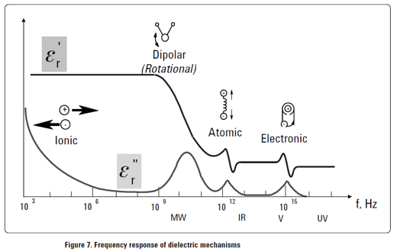
Propagation through dielectrics
Dielectric loss is result of resonance of particles with electromagnetic field – varies with frequency
Oxygen absorption (e.g. at 60 GHz) result of such resonance
Exponential decay with distance

Slide 49

Propagation through dielectrics
Penetration loss increases exponentially with depth and frequency
…
x
Attenuation
Phase change

Slide 50
Propagation through dielectrics
Example: relative permittivity of concrete
@ 5 GHz: ε_{r} = 4.8 – j0.6
@ 60 GHz: ε_{r} = 3.3 – j0.38
Loss of a 3 cm thick slab of concrete
@ 5 GHz:
@ 60 GHz:
How thick can a slab of concrete be for <10dB attenuation?
@ 5 GHz: 8.04 cm
@ 60 GHz: 8.8 mm
Mm-wave cannot propagate through obstacles

Slide 51
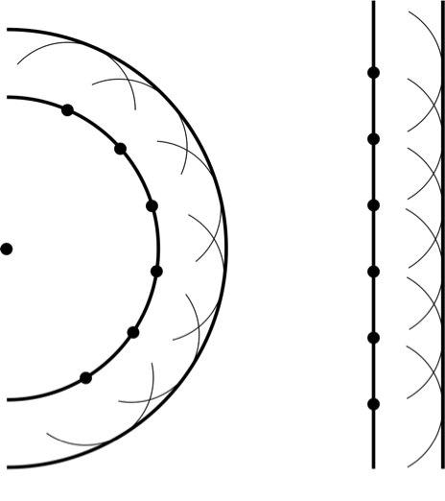
Can we diffract around obstacles?
Need Huygen’s principle to understand this
wavefront decomposition
for point source
wavefront decomposition
for plane wave

Slide 52
Huygens’ principle
If part of wavefront is blocked, contribution of that portion is lost

Slide 53


Huygens’ principle
If part of wavefront is blocked contribution of that portion is lost
equivalent pattern of blocked sources
equivalent pattern of blocked sources

Slide 54
Huygens’ principle
If part of wavefront is blocked contribution of that portion is lost
more of power reaching front of obstacle is lost
equivalent pattern of blocked sources
equivalent pattern of blocked sources

Slide 55
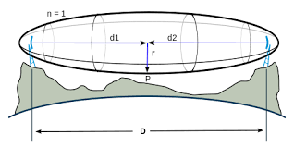









Can mostly write off diffraction
Fresnel zone heuristic
Can’t diffract around human obstacles in picocells, for example

Slide 56
Take-away on blockage
When a path is blocked, it’s blocked
(can’t burn through it, can’t diffract around it)
Must steer around obstacles

Slide 57
OVERALL channel model

Slide 58
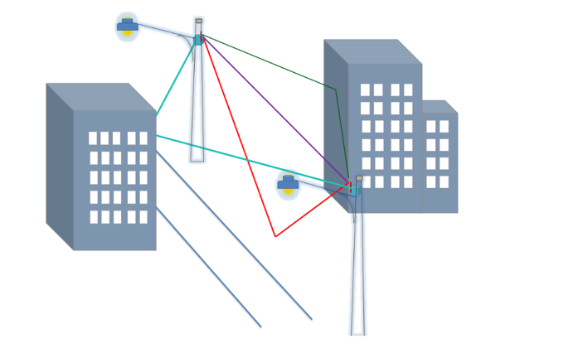
Quasi-deterministic modeling
Example lamppost-to-lamppost link
LoS + single bounce reflections from side walls and road
Can vary lamppost heights and street width to get multiple realizations

Slide 59
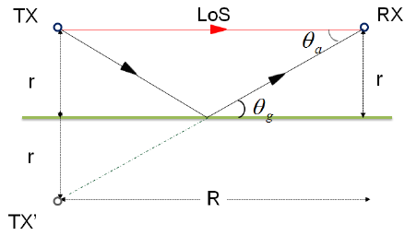
Basic ray tracing
Relative delays: compute using geometry
Path strength: reflection model, propagation distance, beam patterns
Relative phase: uniform (small path length differences cause large
phase differences)

Slide 60
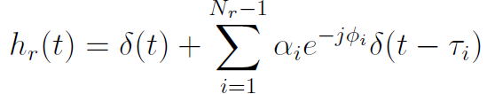
Sparse channel model
Channel impulse response (gains account for TX and RX directivity)
Modeled as uniform over

Slide 61

Sparse channel impulse response

Slide 62
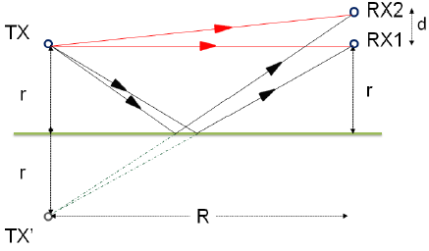
Easily extends to multiple antennas

Slide 63
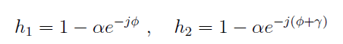
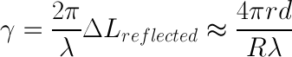
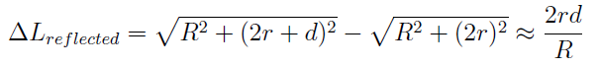
Need to be careful with relative phases
Example SIMO system: relative channel gains are
Phase difference:

Slide 64
Take-away on millimeter wave channel Sparse and geometrically predictable

Slide 65
Take-way on millimeter wave channel Sparse and geometrically predictable
Do measurements back this up?

Slide 66
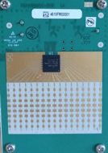
Measurements on UCSB campus
Measurements at different locations on campus
16-element phased array @ 60 GHz
Steers beam in horizontal plane (azimuth)
Facebook Terragraph node
TX
TX angle
(azimuth)
RX angle
(azimuth)
RX
(Narrow vertical beam ➔ ground reflection not present on typical measurements)

Slide 67
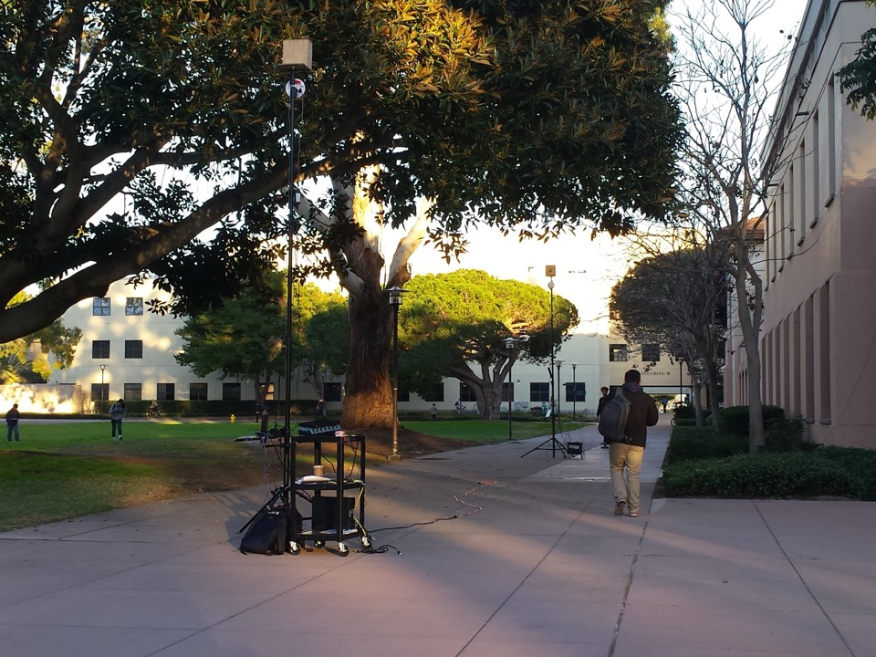

Slide 68
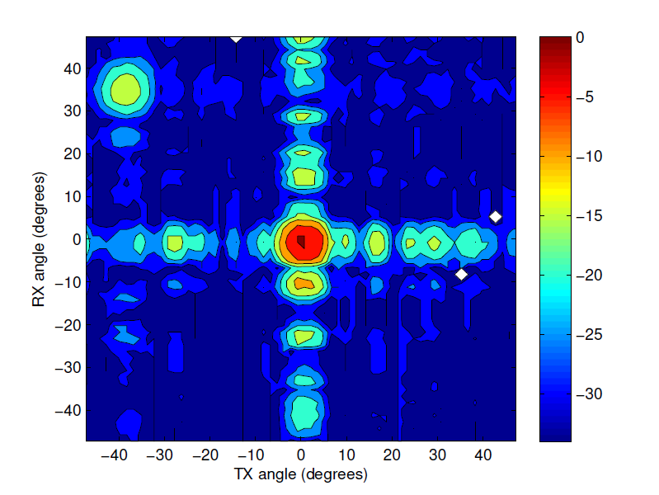
Received power: angular profile
Reflection from window on right wall

Slide 69
Consistent with 2 rays
Receiver sidelobes
Reflection from window on right wall
Transmitter sidelobes

Slide 70
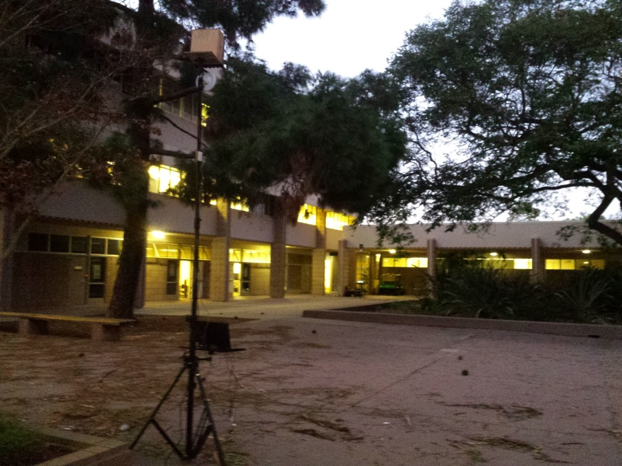
RX

Slide 71
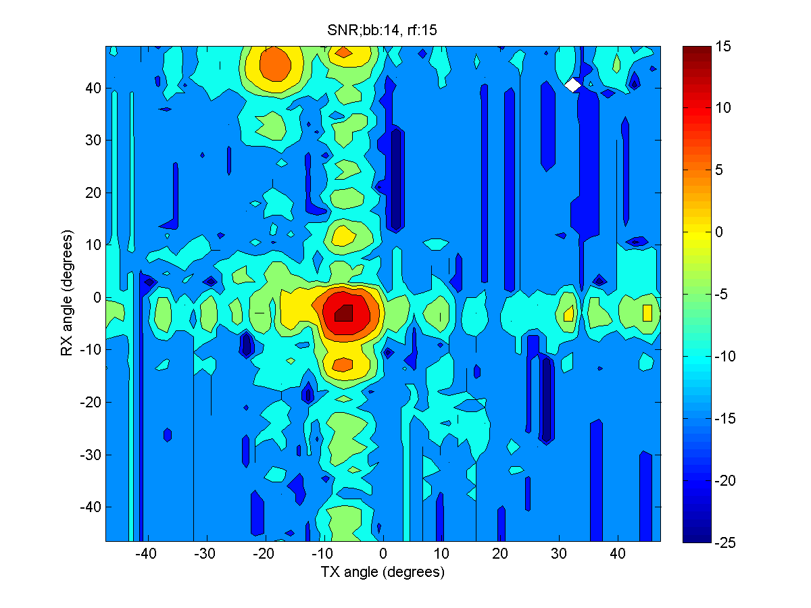
Another 2-ray channel
Reflection from wall near receiver

Slide 72

Reflected path for 2nd ray
RX

Slide 73
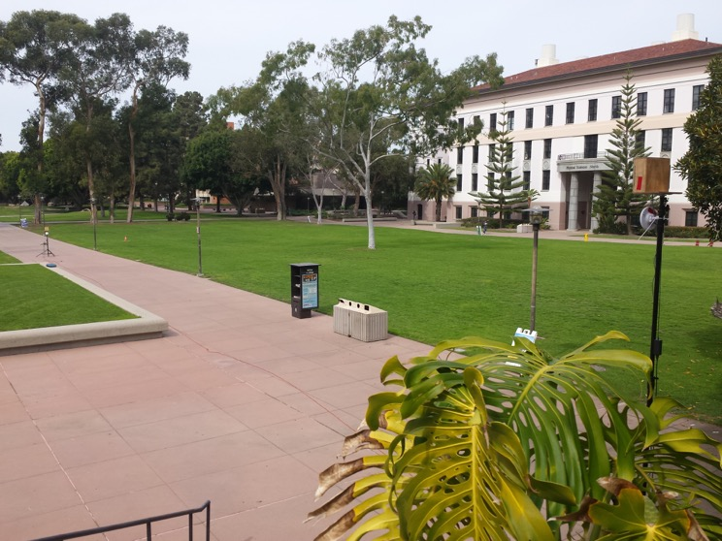
We expect only the LoS path here
TX
RX

Slide 74
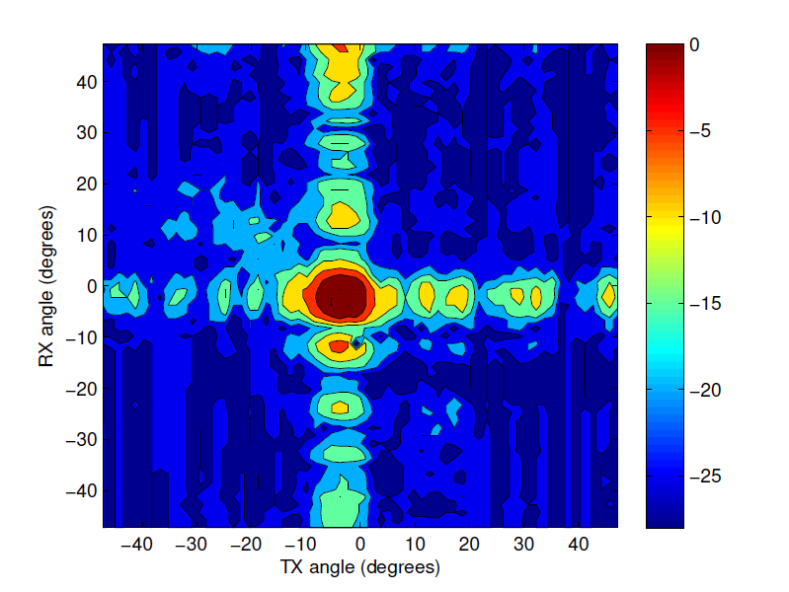
1-ray model

Slide 75
Other measurement campaigns show similar results

Slide 76
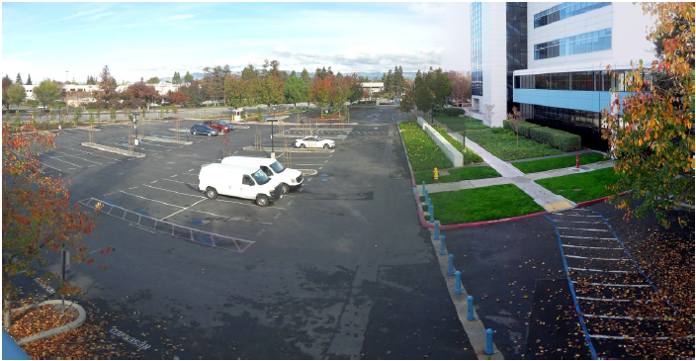
Previous measurement results
Measurement campaign by Weiler et al:
Transmitter performs beamsteering in 2D (azimuth and elevation)
Receiver is omnidirectional
Weiler, R.J., Keusgen, W., Maltsev, A., Kühne, T., Pudeyev, A., Xian, L., Kim, J. and Peter, M., 2016, April. Millimeter-wave outdoor access shadowing mitigation using beamforming arrays. In Antennas and Propagation (EuCAP), 2016 10th European Conference on (pp. 1-5). IEEE.

Slide 77
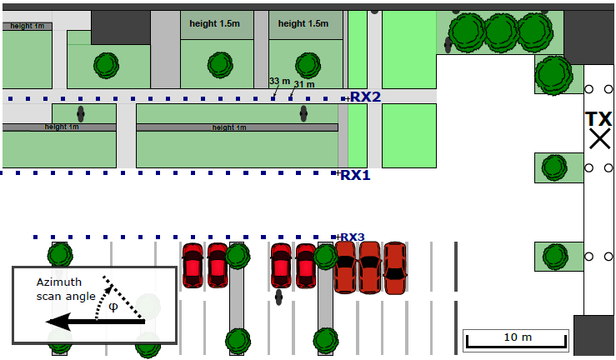
Previous measurement results
Locations 2 and 1

Slide 78
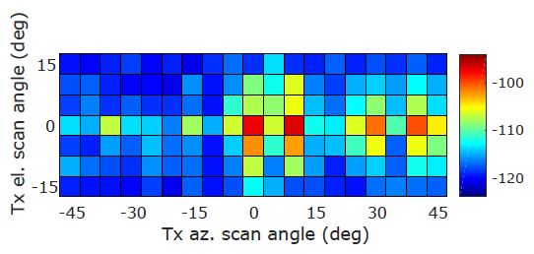
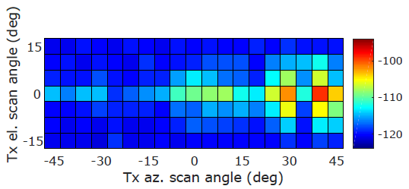
First location
sidelobe
LOS
building reflection
Line of sight free:
LOS blocked by human
Line of sight blocked:

Slide 79


Second location
reflected path is much weaker
Line of sight free:
Line of sight blocked:

Slide 80
Millimeter wave channel is sparse and geometrically predictable
WORTH REPEATING

Slide 81
BEAmforming

Slide 82
Beamforming is critical for utilizing sparse mm-wave channels
Link budgets require directionality
Tiny wavelength ➔ compact steerable antenna arrays

Slide 83
Beamforming basics

Slide 84





Beamforming
Wave front incident from angle θ reaches elements with different phases The signal reaching neighboring elements will have phase lag of k d sin(θ)
wave front
(constant phase planes)
array normal
d sin(θ)
θ
d
. . .
0
1
2
3
N-1
array axis

Slide 85



Beamforming
Receive beamforming: multiply by conjugate of phase offsets for constructive reception of signal coming from angle θ
array normal
d sin(θ)
θ
d
. . .
0
1
2
3
N-1
array axis
. . .
+
N x signal

Slide 86


Beamforming
Transmit beamforming: excite elements with phase offset to generate wave in direction θ
wave front
(constant phase planes)
array normal
d sin(θ)
θ
d
. . .
0
1
2
3
N-1
array axis
. . .
s
signal

Slide 87

Array pattern (as a function of spatial frequency)
When array is beamformed toward angle θ, what is the signal received from angle θ+Δθ?

Slide 88
Array pattern (as a function of physical angle)
When array is beamformed toward angle θ, what is the signal received from angle θ+Δθ?

Slide 89
Array pattern
When array is beamformed toward angle θ, what is the signal received from angle θ+Δθ?

Slide 90
Array pattern
When array is beamformed toward angle θ, what is the signal received from angle θ+Δθ?

Slide 91
What we do today Digital Beamforming
Today’s systems have a small #antennas
#RF chains can’t keep up with mm-wave array scaling
(1)
DAC
upconvert
(2)
DAC
upconvert
…
(N)
DAC
upconvert

Slide 92
In order to scale to large arrays RF beamforming
Single RF chain
Less flexible, more scalable
(1)
Phase
shift
(2)
Phase
shift
DAC
upconvert
…
(N)
Phase
shift

Slide 93

Quantized RF beamforming
Phase shifter hardware
Simplified by quantizing weight phases to a few bits
Analog Attenuator
2-bit phase control

Slide 94
We will assume RF beamforming
But hybrid models are worth exploring

